Slide 1


Week 15 – Anomaly Detection

Slide 2


Slide 3
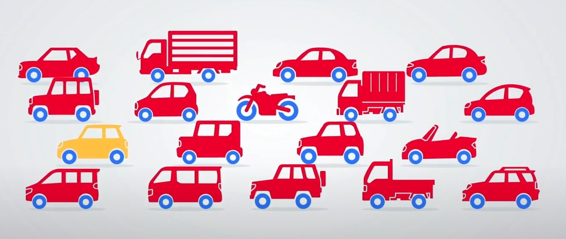
What is anomaly?
Yellow Car
Bike

Slide 4

What is Anomaly Detection
Identifying rare items, events, or observations that raise suspicions by differing significantly from the majority of the data.
Enhances decision-making processes by identifying abnormal behaviors or trends.
Critical in domains where failure to detect anomalies can lead to significant losses (financial, operational, etc.)

Slide 5
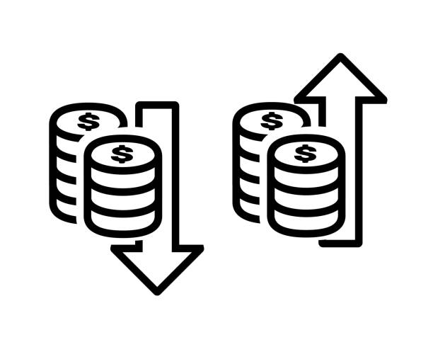
Anomaly vs Outlier
Outlier is when some data points are behaving differently but doesn't contribute to any bad thing.
For example, employees making too high or too low salary.
Anomaly is when something unusual (or unexpected) is experienced by the monitoring system that is alarming.
For example, a user who does 50 - 60 USD purchase daily from card, has done 50000 USD purchase.

Slide 6
EXAMPLES

Slide 7
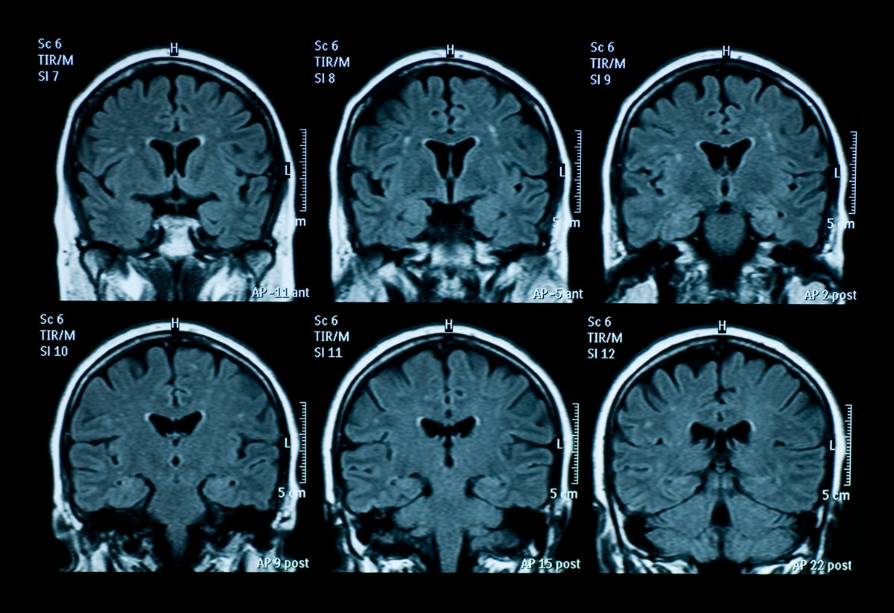
Detecting Cancer in MRI Images

Slide 8
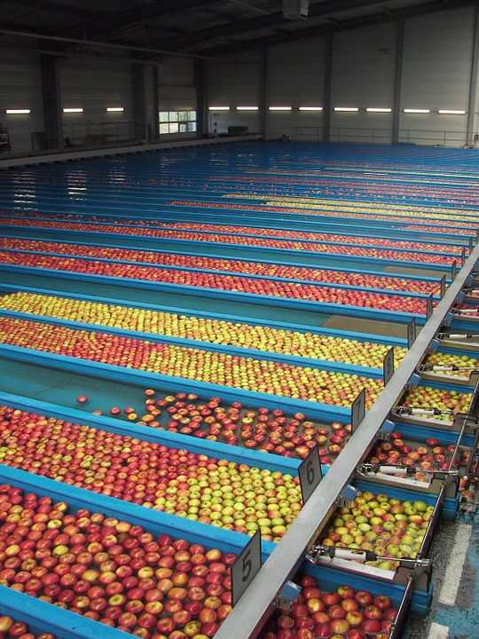
Sorting produce in agriculture

Slide 9
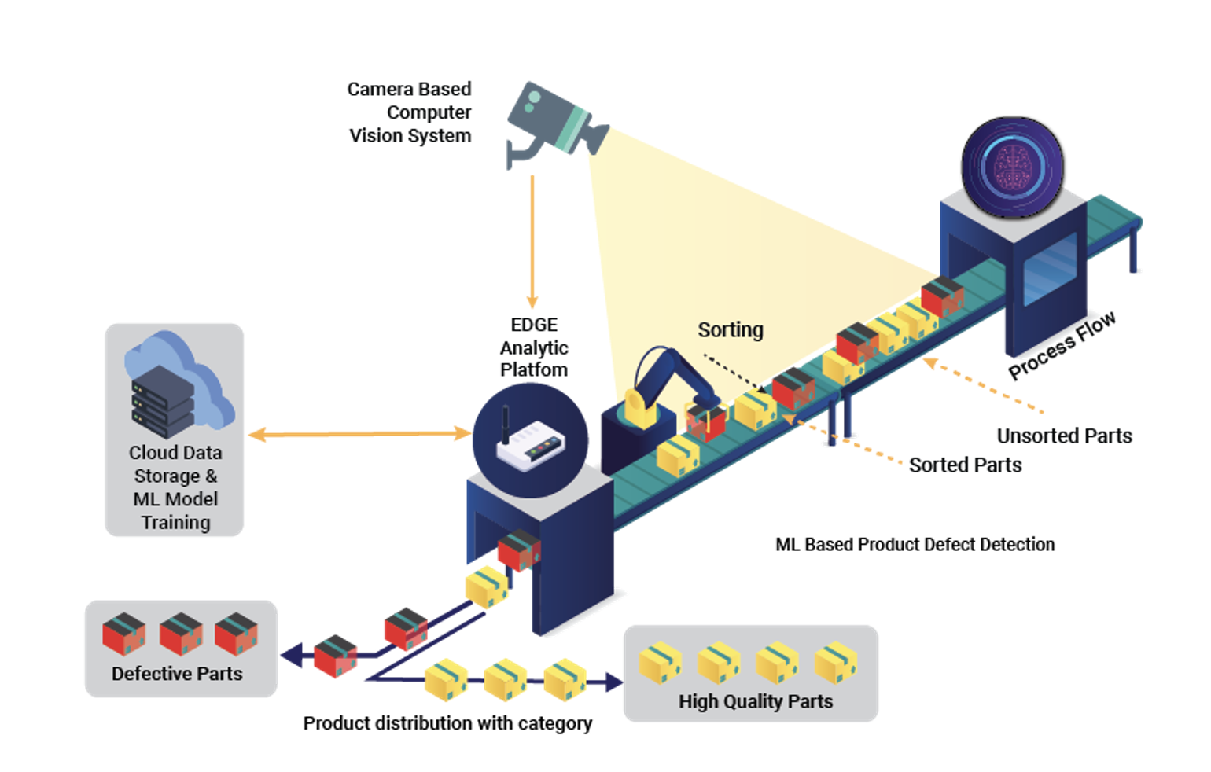
Removing defective parts in an assembly line

Slide 10
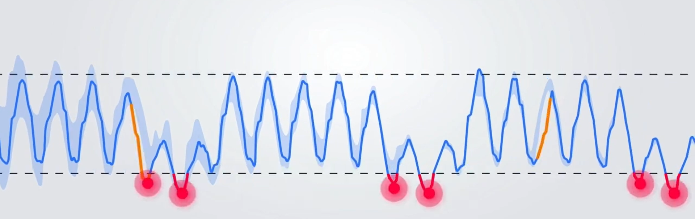
Detecting anomalies in ML
Detecting all anomalies while minimizing false positives

Slide 11
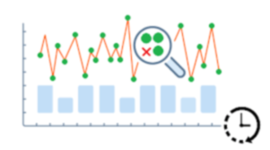
Others
Manufacturing
Cybersecurity
Banking and finance
Healthcare
Travel

Slide 12
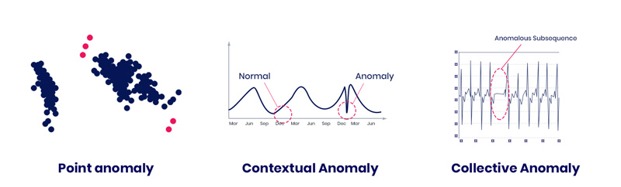
Types of Anomalies
Point Anomalies: Example - A single outlier in a financial transaction dataset.
Contextual Anomalies: Example - A temperature reading that is abnormally high during winter but normal in summer.
Collective Anomalies: Example - A series of transactions that together indicate fraud.

Slide 13
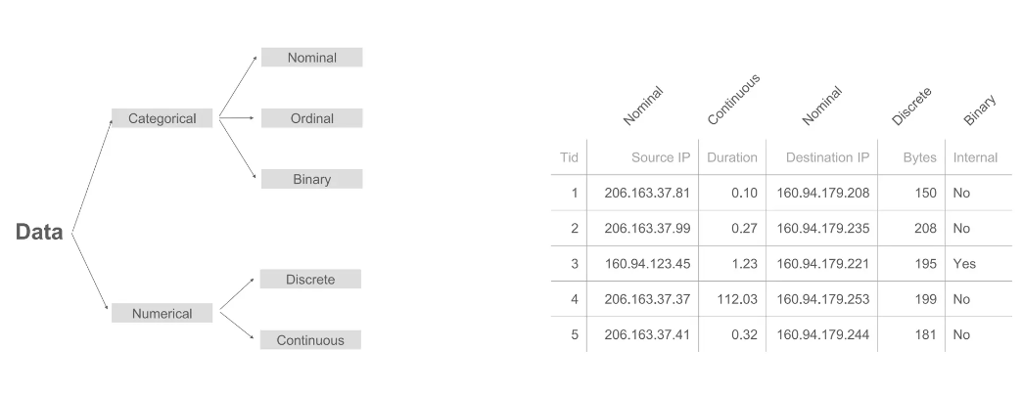
Data characteristics

Slide 14
Challenges in Anomaly Detection
Imbalanced Data: Anomalies are often vastly outnumbered by normal data.
Dynamic and Evolving Data: Anomalies change as new data comes in.
Feature Selection and High Dimensionality: Identifying which features are relevant for detecting anomalies.

Slide 15
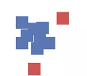


Techniques for Anomaly Detection
Supervised Learning
Requires labeled normal and anomalous data.
Effective when there is a clear distinction between normal and anomalous data.
Unsupervised Learning
Detects anomalies without labeled data.
Common methods: k-means clustering, DBSCAN, Isolation Forest.
Semi-Supervised Learning
Uses a mix of labeled and unlabeled data.
Effective when labeled data is scarce.

Slide 16
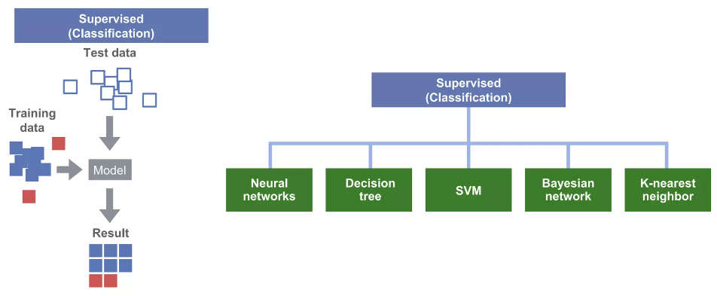
Supervised learning

Slide 17
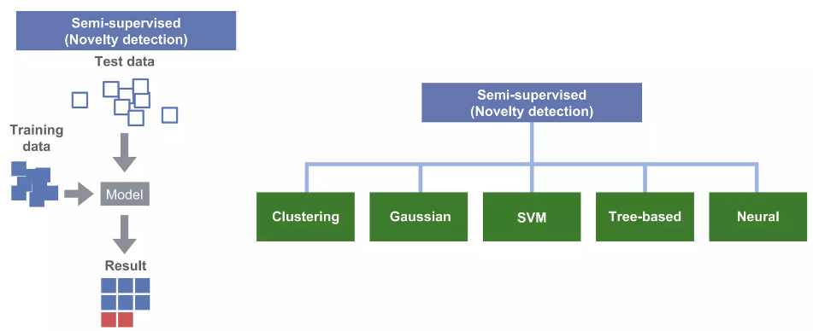
Semi Supervised learning

Slide 18
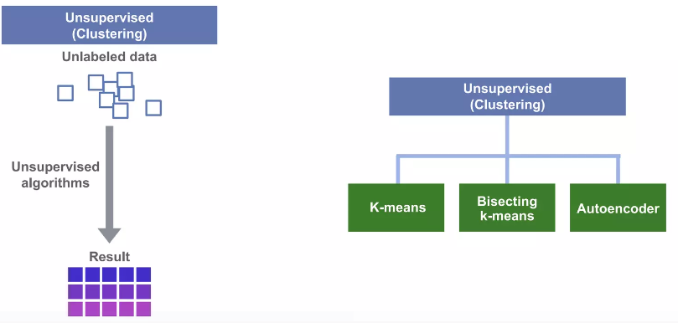
Unsupervised learning

Slide 19
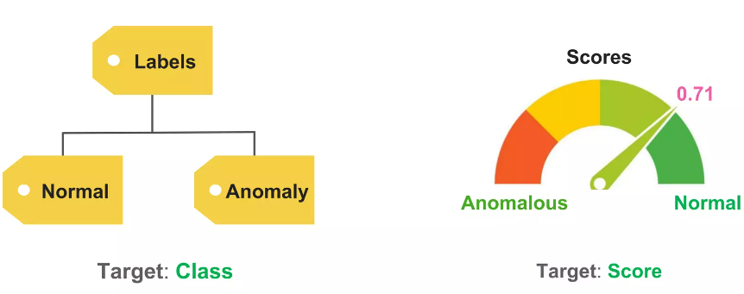
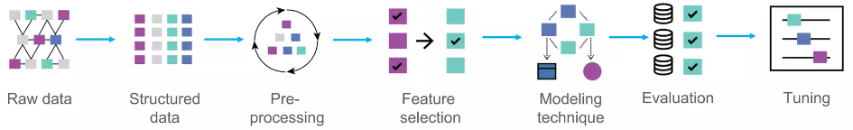
Target
Process

Slide 20
Example using k-Mean
Choose the number of clusters 𝑘k.
Initialize 𝑘k centroids randomly.
Assign each data point to the nearest centroid to form 𝑘k clusters.
Recalculate the centroids of the clusters.
Repeat the assignment and centroid update steps until convergence (i.e., the assignments no longer change or the change is below a threshold).
Given a dataset of customer transactions, use k-means clustering to group similar transactions.
Calculate the distance of each transaction to its cluster centroid.
Transactions with distances significantly larger than others in the same cluster are flagged as potential fraudulent activities.

Slide 21
Deep Learning Methods
Autoencoders: Neural networks trained to compress and reconstruct data, anomalies have higher reconstruction errors.
GANs (Generative Adversarial Networks): Used to generate normal data; anomalies are identified when data points deviate from this normal pattern.

Slide 22
Evaluation Metrics
Precision: The ratio of true positives to the sum of true and false positives.
Recall: The ratio of true positives to the sum of true positives and false negatives.
F1-Score: The harmonic mean of precision and recall.
ROC Curve and AUC: Plot true positive rate against false positive rate; AUC measures the area under the ROC curve.

Slide 23
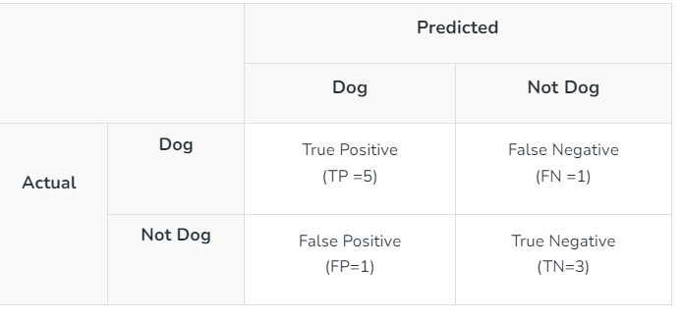
Evaluation Metric Example

Slide 24



Accuracy = (5+3)/(5+3+1+1) = 8/10 = 0.8
Precision = 5/(5+1) =5/6 = 0.8333
F1-Score: = (2* 0.8333* 0.8333)/( 0.8333+ 0.8333) = 0.8333

Slide 25
Python code
true_positives = 40
false_positives = 10
false_negatives = 5
precision = true_positives / (true_positives + false_positives)
recall = true_positives / (true_positives + false_negatives)
f1_score = 2 * (precision * recall) / (precision + recall)
print(f"Precision: {precision}")
print(f"Recall: {recall}")
print(f"F1-Score: {f1_score}")

